Slide 1
Digital Portfolio
STUDENT NAME: HARISH B
REGISTER NO AND NMID: 7A4222B02C7EB99BB7E4999C616F0827
DEPARTMENT: BCA
COLLEGE: Akshaya Collage Of Arts and Science / Bharathiyar University

Slide 2
PROJECT TITLE
VistaFolio – A Minimal Gradient Portfolio

Slide 3
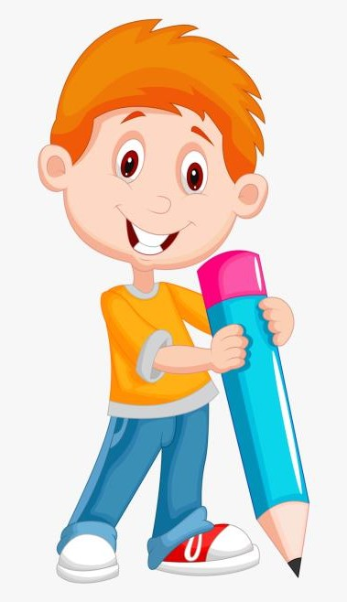

AGENDA
Problem Statement
Project Overview
End Users
Tools and Technologies
Portfolio design and Layout
Features and Functionality
Results and Screenshots
Conclusion
Github Link
3/21/2024 Annual Review

Slide 4

PROBLEM STATEMENT
Many portfolios today feel either too plain to be memorable or too overloaded with visuals to stay professional. For students and professionals who want to strike the right balance, this becomes a challenge. A clean and calming design with gradients can help present skills and projects in a way that’s both elegant and engaging without being overwhelming.

Slide 5

PROJECT OVERVIEW
VistaFolio is a minimal yet elegant portfolio website designed with soft gradients and subtle glassmorphism. It blends professionalism with creativity, offering a calm, modern look that doesn’t overwhelm the content. Built using HTML, CSS, and JavaScript, VistaFolio is fully responsive, lightweight, and aesthetically pleasing.

Slide 6

WHO ARE THE END USERS?
🎓 Students – who want a polished yet simple academic portfolio.
💼 Job Seekers – looking for a clean and professional online presence.
🎨 Designers & Artists – who want an elegant platform to showcase their work.
👨‍💻 Developers – who want a minimal but modern digital identity.

Slide 7

TOOLS AND TECHNIQUES
Frontend: HTML5, CSS3, JavaScript
Editor: Visual Studio Code
Hosting: GitHub Pages / Netlify
Design Style: Soft gradients, glassmorphism cards, rounded UI, smooth animations

Slide 8
POTFOLIO DESIGN AND LAYOUT
Header: Soft gradient background with brand title
Navigation: Floating navbar with smooth underline hover animation
Home Section: Welcome message with a gradient call-to-action button
About Section: Profile card with circular image + glass-effect description box
Projects Section: Gradient-hover project cards with soft shadows
Contact Section: Simple, centered links with pastel gradient hover
Footer: Minimal gradient footer with copyright
‹#›

Slide 9
FEATURES AND FUNCTIONALITY
✨ Gradient-based theme for modern visuals
🚀 Smooth navigation using JavaScript
🖱️ Interactive hover effects on projects and links
📂 Organized project showcase with clean design
📱 Responsive design that works across desktop, tablet, and mobile
💡 Glassmorphism effect to give a futuristic yet subtle style

Slide 10

RESULTS AND SCREENSHOTS
✅ Created a portfolio with a calm, elegant, and professional vibe
✅ Added gradient and glass effects for uniqueness
✅ Ensured smooth animations and responsive design
✅ Balanced professionalism with creativity
✅ Works seamlessly on multiple devices
3/21/2024 Annual Review
‹#›

Slide 11
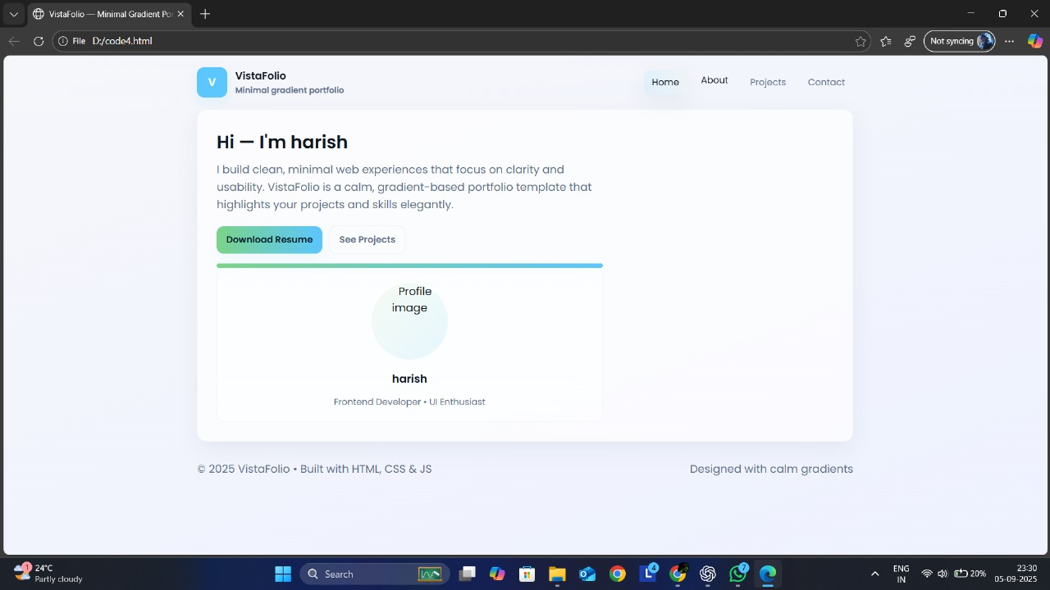

Slide 12
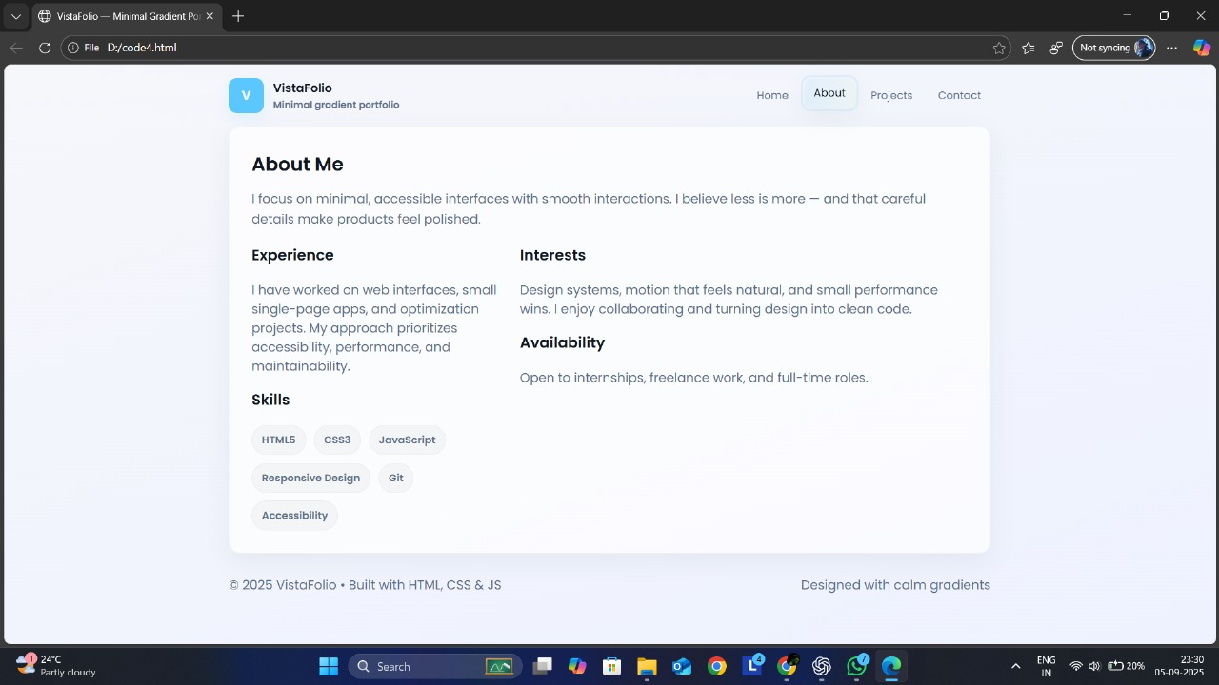

Slide 13
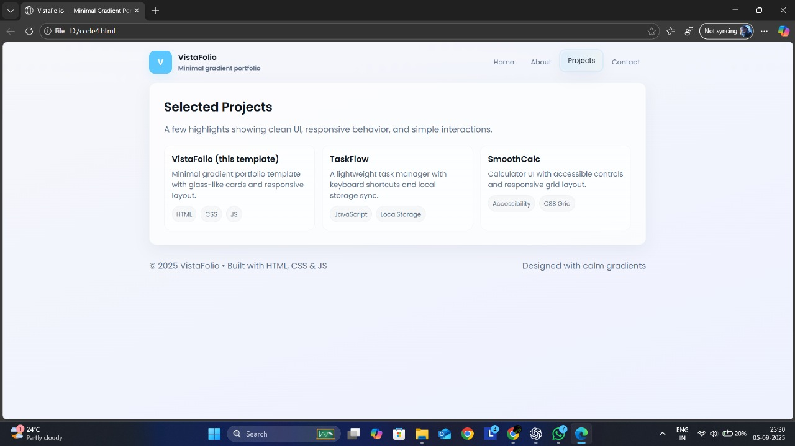

Slide 14
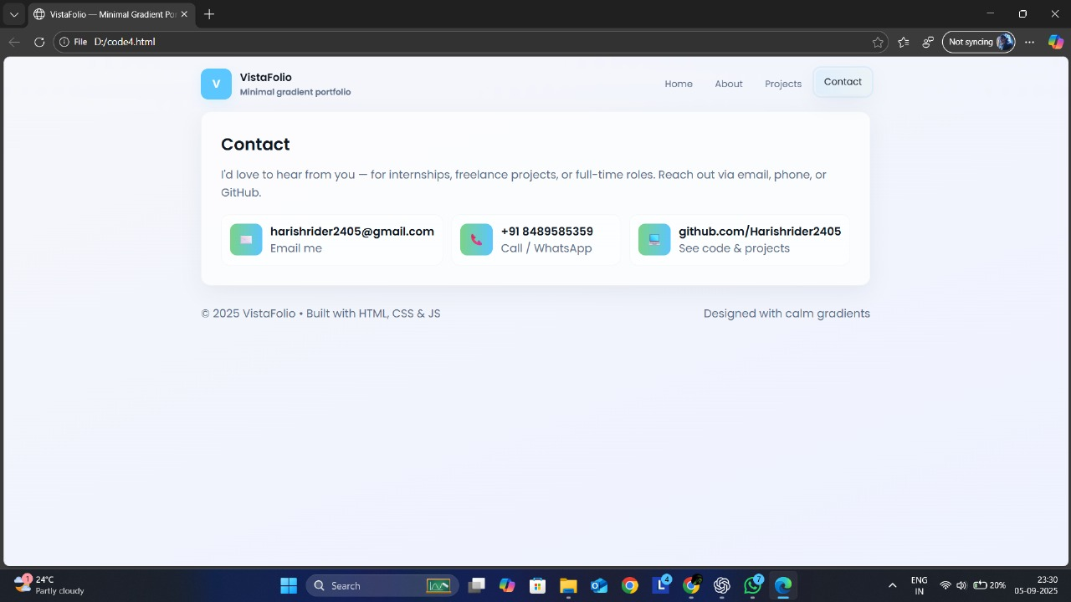

Slide 15
CONCLUSION
The VistaFolio project shows how portfolios can be both minimal and creative. By using gradients and glassmorphism, it achieves a calm, modern, and professional look that helps students, job seekers, and creators stand out. It’s proof that even with simple web technologies, you can design a portfolio that’s memorable, polished, and future-ready.
‹#›

